Slide 1
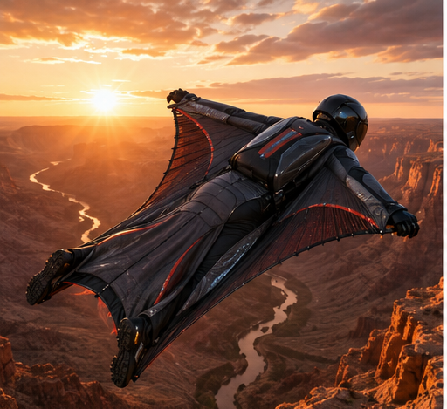

DragonWorx
BIOMIMETIC TECHNOLOGIES
Nature spent 4 billion
years solving hard problems.
We read the engineering manual
it left behind — and build things with it.
Investor Presentation · Seed Round · 2026
Evan Norman, Founder
512.550.4018
getdragons@dragonworx.bio
dragonworx.bio

Slide 2
THE OPPORTUNITY
Every wingsuit ever made
was designed by feel.
NO CFD
Zero computational fluid dynamics used in the design of any commercial wingsuit. Practitioners sewed fabric, jumped, and iterated if they survived.
NO AEROSPACE MATERIALS
No shape-memory polymers, no auxetic metamaterials, no aerospace surface science. Nylon and zippers — the same construction as 1990.
PERFORMANCE CEILING REACHED
Best wingsuits achieve ~2.5:1 glide ratios. That number has not improved in fifteen years. The empirical methodology exhausted itself.
BIOLOGY HAS THE ANSWER
The humpback whale, mako shark, peregrine falcon — each solved the same physics problems over millions of years. Nobody built a suit from those blueprints.
DRAGONWORX BIOMIMETIC TECHNOLOGIES · CONFIDENTIAL
OPPORTUNITY

Slide 3
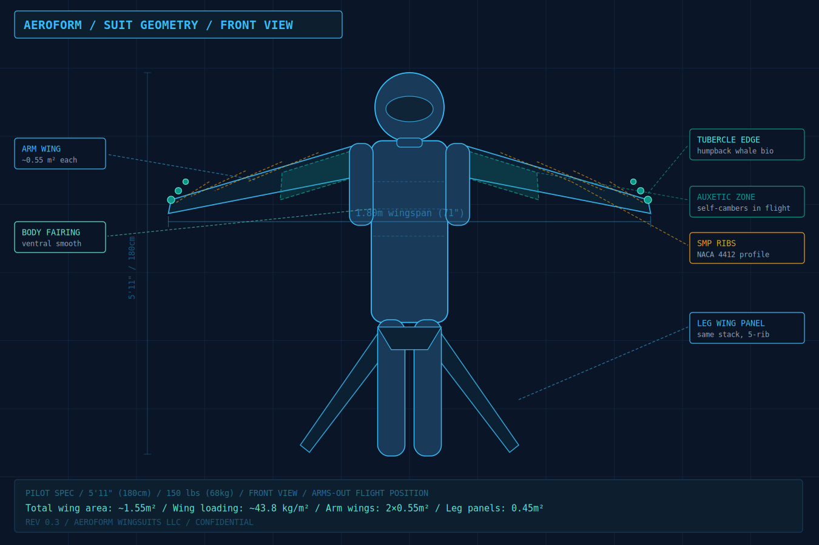
THE SOLUTION
Physics first. Materials second. Suit last.
DragonWorx applies biological mechanisms — reverse-engineered at the physics level, replicated through metamaterial fabrication — to human wearable performance systems. Every product traces to a biological blueprint validated over millions of years, with death as the rejection criterion.
14
5
TRL 2–6
$1.8M
Biomimetic technologies
Product domains
Active development range
Seed round in progress
METHODOLOGY
1. Identify
2. Reverse-engineer
3. Fabricate
4. Iterate
5. Ship
Biological mechanism with validated physics
Physics at material level — not surface-level mimicry
Metamaterial path that replicates at human scale
Adversarial AI + Kaizen discipline at every stage
Consumer validates; military and industrial scale revenue
DRAGONWORX BIOMIMETIC TECHNOLOGIES · CONFIDENTIAL
SOLUTION

Slide 4
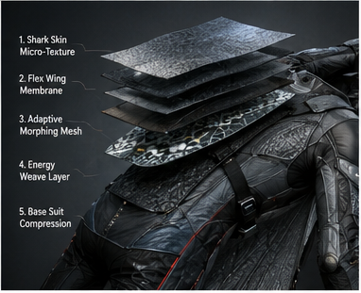
PROJECT A — DRAGONSUIT
The first wingsuit designed from
aerospace materials science.
🐋
TUBERCLE LEADING EDGES
TRL 4
Humpback fin geometry applied to arm-wing leading edge. Delays stall from 22° to 28° AoA. Discrete spanwise cells via controlled micro-turbulence injection.
🔬
AUXETIC METAMATERIAL PANELS
TRL 4
Negative Poisson's ratio re-entrant lattice. Under aerodynamic load, lateral expansion self-cambers the wing into a higher-lift profile. Zero sensors, zero motors.
🦴
SHAPE-MEMORY POLYMER SKELETON
TRL 4
DiAPLEX SMP ribs profiled to NACA 4412. Holds wing geometry under full aerodynamic load. Resets to flat at body heat (~37°C). Single largest share of glide improvement.
🦈
SHARK-DENTICLE RIBLET FILM
TRL 6
Laser-etched V-groove confines quasi-streamwise vortices, reducing skin friction drag 8–10%. Production-validated: Speedo Fastskin + Lufthansa Technik programs.
🔀
ANISOTROPIC WASHOUT WEAVE
TRL 4–5
High-modulus fibers spanwise, compliant fibers in twist direction. Passive tip twist 3–5° nose-down under load. Prevents tip stall through material stiffness gradient alone.
🦅 Peregrine Tip Slots — TRL 3 | Load-passive slot opening converts tip vortex energy to forward thrust. Largest remaining performance gain.
DRAGONWORX BIOMIMETIC TECHNOLOGIES · CONFIDENTIAL
DRAGONSUIT TECH

Slide 5
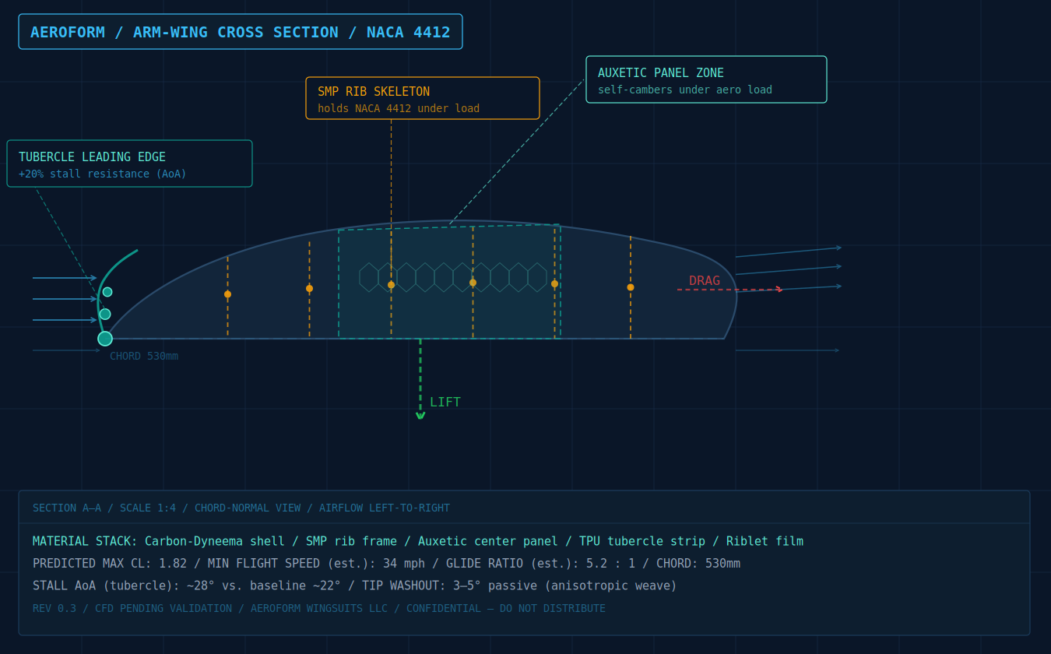
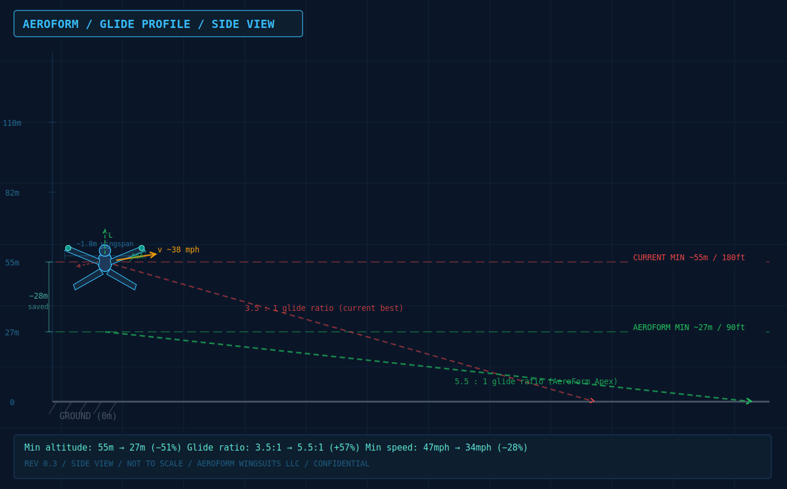
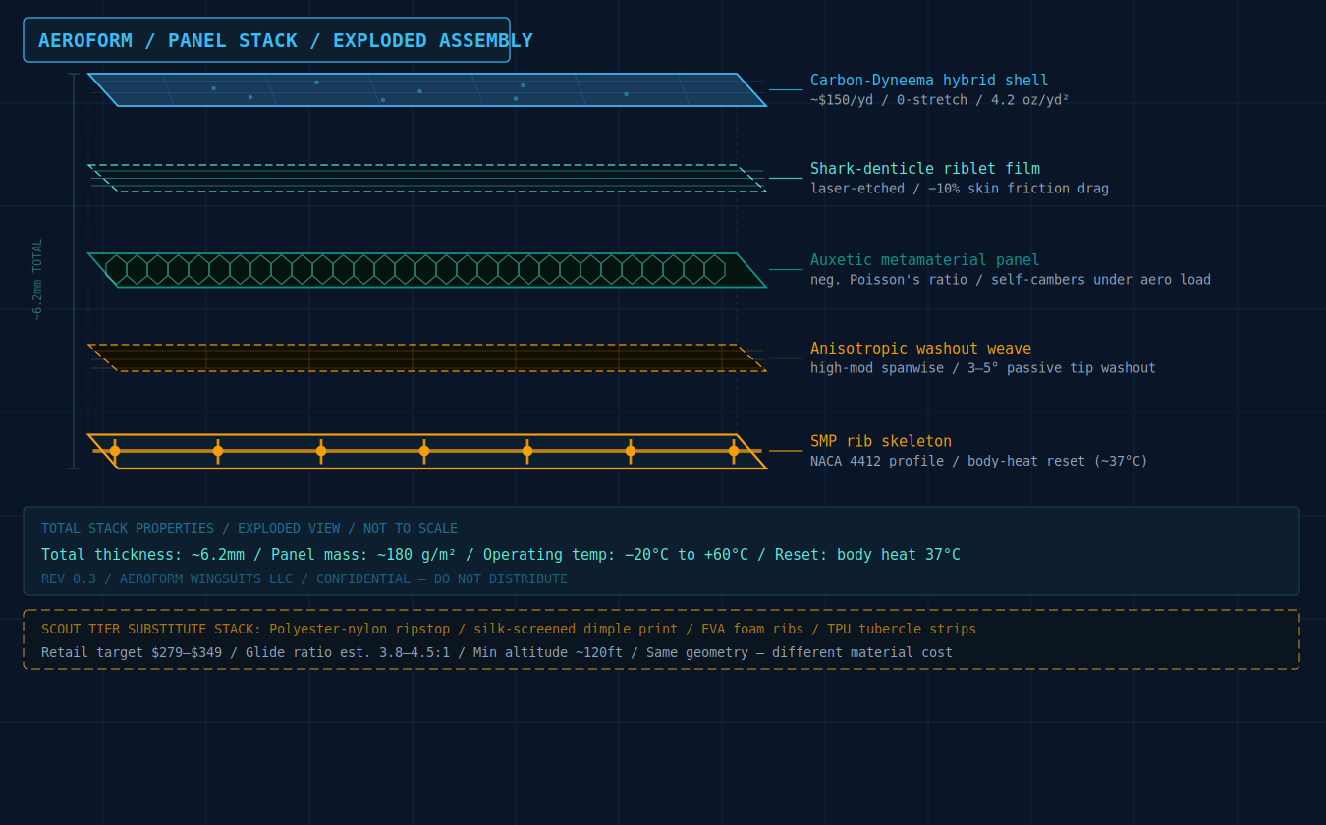
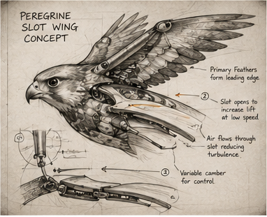
ENGINEERING DIAGRAMS
The physics, drawn.
01 — NACA 4412 cross-section
02 — Glide profile comparison
03 — Five-layer panel stack
04 — Peregrine slot-wing
with material annotations
current best vs. DragonSuit Apex
exploded assembly view
biological reference sketch
DRAGONWORX BIOMIMETIC TECHNOLOGIES · CONFIDENTIAL
DIAGRAMS

Slide 6
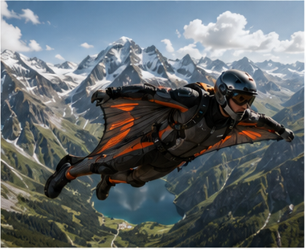
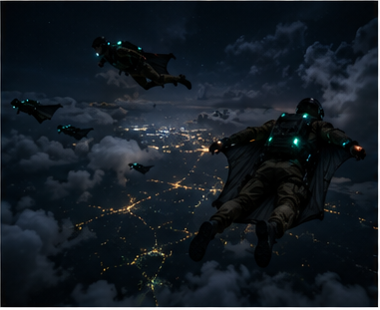
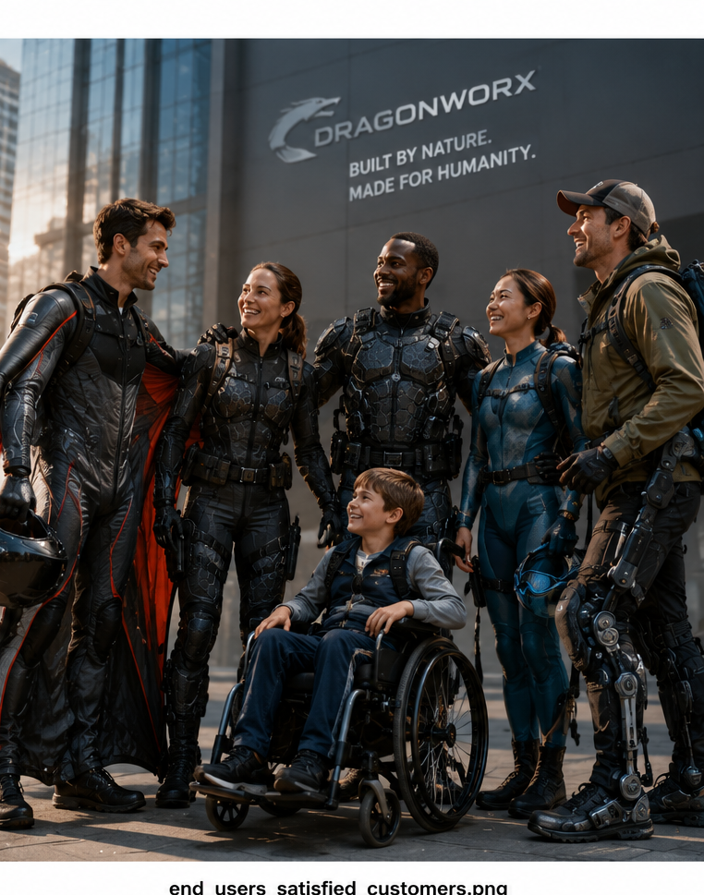
PRODUCT LINE
Four SKUs. Three markets.
CONSUMER · ENTRY
ELITE PILOTS
MILITARY · SOF
SEARCH & RESCUE
DragonSuit Scout
DragonSuit Apex
DragonSuit Apex-M
DragonSuit Apex-SAR
$279 – $349
$10K – $18K
$28K – $45K
$18K – $24K
Glide 3.8–4.5:1
Min Alt ~37 m / 120 ft
Glide 5.0–6.0:1
Min Alt ~27 m / 90 ft
Glide 5.0–6.0:1
Min Alt <27 m / 90 ft
Glide 5.0–6.0:1
Min Alt ~27 m / 90 ft
EVA foam ribs + TPU tubercle strip
Full 5-layer SMP biomimetic stack
Helicoidal CFRP + NIJ ballistic + MOLLE
Beacon integration + high-vis panels
Glide ratio and altitude are design targets based on CFD simulation and published component literature. Wind tunnel validation planned at UT Arlington ARC.
DRAGONWORX BIOMIMETIC TECHNOLOGIES · CONFIDENTIAL
PRODUCT LINE

Slide 7
MARKET OPPORTUNITY
Three addressable markets. One materials platform.
🪂
CONSUMER & SPORT
$420M
🎖️
MILITARY / SOF
$2.4B
TAM
TAM
Global wingsuit, BASE, and skydiving equipment market. Scout SKU ($279–349) as the entry validation product. Growing 8% CAGR driven by extreme sport participation.
US SOF wearable systems procurement. Apex-M addresses a passive low-observable insertion capability gap. SOCOM has independent acquisition budget. Highest-margin channel.
🔭
SEARCH & RESCUE
$180M
🏭
INDUSTRIAL PLATFORM
$12B+
TAM
TAM
Apex-SAR targets government and NGO SAR operators. Beacon integration + high-vis panels. Lower-friction entry parallel to military procurement.
The metamaterials platform licenses into robotics, aerospace manufacturing, and semiconductor handling. The suit validates the technology. The platform licenses into markets that dwarf the suit.
DRAGONWORX BIOMIMETIC TECHNOLOGIES · CONFIDENTIAL
MARKET

Slide 8
COMPETITIVE ADVANTAGE
The platform is the moat.
The products are the revenue.
🧬
BIOLOGY AS IP
🏭
FABRICATION PATH
Four hundred million years of validated R&D — none of it patented. The blueprints predate IP law by an inconvenient margin.
The performance gap was never in the biology. It was in the ability to fabricate the geometry at human scale. That path opened in the last five years.
🤖
ADVERSARIAL AI DESIGN
⚡
KAIZEN DISCIPLINE
AI models run against every design assumption — not to confirm, but to break. TRLs sourced from literature. Failure modes published. No internal optimism in the roadmap.
Stop the line when something looks like it will break. Fix it before moving forward. Toyota and Dalio proved this works. We've built it into the design protocol.
📐
PLATFORM ARCHITECTURE
🔒
DEFENSE MOAT
14 technologies, 5 domains, one methodology. Each product validates the platform. Each platform layer seeds the next product.
SOF insertion and covert access capabilities don't get commoditized. First-mover in a procurement channel with sticky, recurring revenue.
DRAGONWORX BIOMIMETIC TECHNOLOGIES · CONFIDENTIAL
MOAT

Slide 9

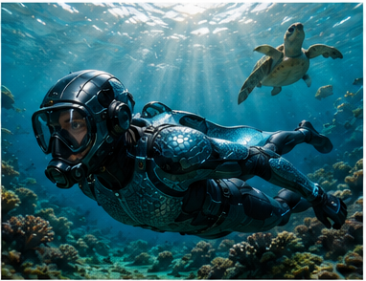
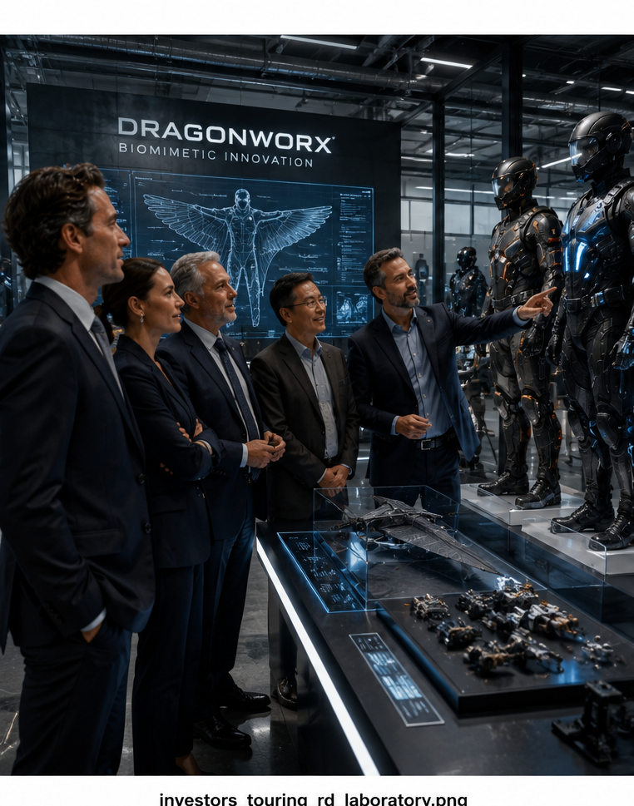
PLATFORM ROADMAP
The DragonSuit validates the platform.
The platform funds everything else.
NOW
12–18 MO
18–30 MO
24–36 MO
DragonSuit
GripSuit
AquaSuit
ArmorSuit + Platform Licensing
Consumer + Military
$1.8M seed round
Gecko Van der Waals
TRL 5 — highest readiness
Boxfish hull + denticles
TRL 3–5
Bouligand CFRP · TRL 5–6
Industrial licensing
DRAGONWORX BIOMIMETIC TECHNOLOGIES · CONFIDENTIAL
ROADMAP

Slide 10
DEFENSE MARKET POSITIONING
Anduril automates the battlefield.
DragonWorx upgrades the operator.
For the missions automation cannot complete.
Anduril
DragonWorx
Automates the battlefield
Upgrades the operator
→ Lattice OS — AI command & control
→ DragonSuit Apex-M — passive SOF insertion, 2× glide ratio
→ Sentry — autonomous surveillance towers
→ GripSuit Apex-M — silent covert structure access
→ Fury — autonomous combat aircraft
→ ArmorSuit — Bouligand CFRP ballistic protection
→ EagleEye — AR battlefield awareness helmet
→ SensorSuit — passive 2m electroreception, no signal emitted
→ Loitering munitions · counter-drone systems
→ ElectraSuit — body-motion powered sensing layer
Doctrine: Remove the human from danger
Doctrine: Extend the operator where machines cannot go
DRAGONWORX BIOMIMETIC TECHNOLOGIES · CONFIDENTIAL
DEFENSE POSITIONING

Slide 11
VALIDATION & RESEARCH PARTNERS
Grounded in peer-reviewed literature.
Validated by external institutions.
🎓
UT ARLINGTON — MAE
🔬
UT DALLAS — APRL (PROF. WALTER VOIT)
Wind tunnel: First funded milestone
SMP fabrication partner target
Active NSF biomimetic composites grant (Prof. Wen Lin). SMP/smart materials faculty (Prof. Stefan Dancila). Low-speed wind tunnel on campus. DragonSuit aerodynamic validation venue. 15 min from Richardson HQ.
Inventor of Mnemosynation — injection-moldable thermoset SMP with independently tunable Tg (23–70°C) and rubbery modulus. DARPA Young Faculty Award. Director, Center for Applied AI. 10 min from HQ.
🏛️
DARPA / Z-MAN PROGRAM (2014)
✈️
SPEEDO / LUFTHANSA TECHNIK
GripSuit TRL 5 — external validation
DragonSuit riblet film: TRL 6 validated
Full human body-weight Van der Waals adhesion demonstrated on vertical glass: 100 kg climber with 22 kg pack ascending 7.6m. Core mechanism validation for GripSuit. Published result — not proprietary.
Shark-denticle riblet drag reduction (8–10%) production-validated in Fastskin competition swimwear and Lufthansa Technik commercial aircraft fuselage programs. Highest-TRL technology in the DragonSuit stack.
DRAGONWORX BIOMIMETIC TECHNOLOGIES · CONFIDENTIAL
VALIDATION

Slide 12
REVENUE MODEL
Consumer validates. Military margins.
Platform licenses.
CONSUMER / SPORT
MILITARY / SOF
SAR / GOV
PLATFORM LICENSING
$279–$18K
$28K–$45K
$18K–$24K
Royalty / SRA
Avg. order value
Avg. order value
Avg. order value
Avg. order value
Gross Margin
Gross Margin
Gross Margin
Gross Margin
45–60%
65–75%
60–70%
80%+
Timing: Year 1
Timing: Year 2
Timing: Year 2
Timing: Year 3+
Scout + Apex
Apex-M
Apex-SAR
Industrial IP
We are not an academic exercise. Our operating model: prototype to market, revenue funds the next iteration, repeat. Consumer validates the methodology. Military is the margin. Industrial platform is the exit.
DRAGONWORX BIOMIMETIC TECHNOLOGIES · CONFIDENTIAL
REVENUE MODEL

Slide 13
USE OF FUNDS
$1.8M Seed Round
28%
WIND TUNNEL VALIDATION
$504K
DragonSuit aerodynamic stack — UTA ARC low-speed tunnel. TRL 4 → 5–6. Tubercle, auxetic, and SMP rib geometry validation.
32%
FIRST-ARTICLE APEX PROTOTYPE
$576K
Full 5-layer composite stack fabrication. SMP rib skeleton + auxetic panel manufacturing. Pilot fit validation. Pre-production tooling.
18%
GRIPSUIT NANO-PILLAR PILOT RUN
$324K
Polyurethane nano-pillar array pilot production. Fluoropolymer tip-cap deposition. Electrostatic augmentation layer. Pad area testing.
12%
RESEARCH PARTNERSHIPS (UTA/UTD)
$216K
Sponsored research at UTA MAE and UTD APRL. Graduate researchers. Lab access. SMP formulation development with Prof. Voit.
10%
OPERATIONS & IP
$180K
Delaware C-Corp formation. IP assignment. Patent filings on auxetic panel geometry, nano-pillar backing substrate, and SMP rib integration.
DRAGONWORX BIOMIMETIC TECHNOLOGIES · CONFIDENTIAL
USE OF FUNDS

Slide 14
TECHNOLOGY READINESS
TRL sourced from peer-reviewed literature,
not internal optimism.
Technology
TRL
External Validation Basis
DragonSuit — Shark Riblet Film
6
Production-validated: Speedo Fastskin + Lufthansa Technik fuselage programs
ArmorSuit — Helicoidal CFRP
6
Bouligand layup validated for armor applications across multiple published studies
GripSuit — Van der Waals Adhesion
5
DARPA Z-Man: full human body weight on vertical glass (2014, published)
JumpSuit — Resilin Spring Joints
5
Carbon fiber leaf-spring bistable mechanism validated at component scale
DragonSuit — SMP Rib Skeleton
4
DiAPLEX SMP + NACA profiling — component-level lab validation
DragonSuit — Auxetic Metamaterial
4
Re-entrant lattice self-cambering under load — validated at component scale
DragonSuit — Tubercle Leading Edge
4
Humpback geometry wind tunnel data published in multiple aerodynamics studies
DragonSuit — Anisotropic Washout
4
Fiber-schedule washout mechanism — composite mechanics literature
AquaSuit — Boxfish Hull + Plastron
3
CFD-validated hull geometry; air plastron mechanism lab demonstrated
ElectraSuit — PVDF + Electroreception
3
PVDF harvesting and flexible electrode sensing — validated at lab scale
SensorSuit — Passive Electroreception
3
Graphene electrode array sensing validated; wearable integration pending
SentinelSuit — UV IFF + Microfluidics
2
Beta-carboline UV fluorescence validated; microfluidic wound seal conceptual
PropulsionSuit — Chemical Micro-Thruster
2
Bombardier beetle chemistry documented; PDMS thruster conceptual stage
DRAGONWORX BIOMIMETIC TECHNOLOGIES · CONFIDENTIAL
TRL MATRIX

Slide 15

DRAGONWORX
BIOMIMETIC TECHNOLOGIES
The biology already
proved it works.
The fabrication path
now exists.
We're building
the products.
$1.8M seed round open.
Wind tunnel validation → first-article Apex → GripSuit nano-pillar pilot.
Evan Norman · Founder
512.550.4018 · getdragons@dragonworx.bio · dragonworx.bio
Richardson, Texas

